Slide 1

TEAM 1

Slide 2

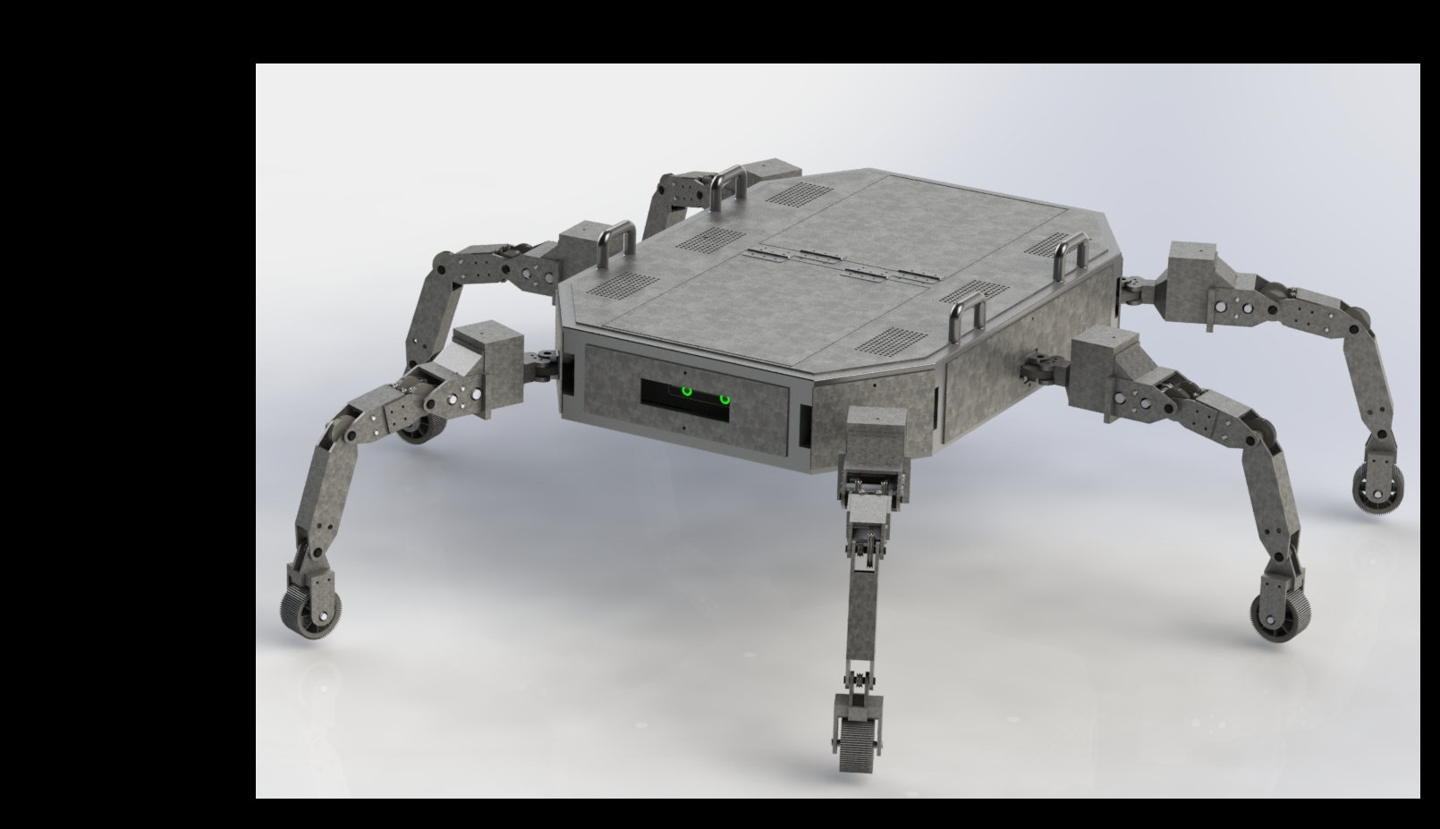
Tactical Unmanned Ground Vehicle for Close-Quarters Surveillance & Combat
Course: Machine Design
Instructor: Prof. Shantanu Tripathi

Slide 3
Problem Statement

Slide 4
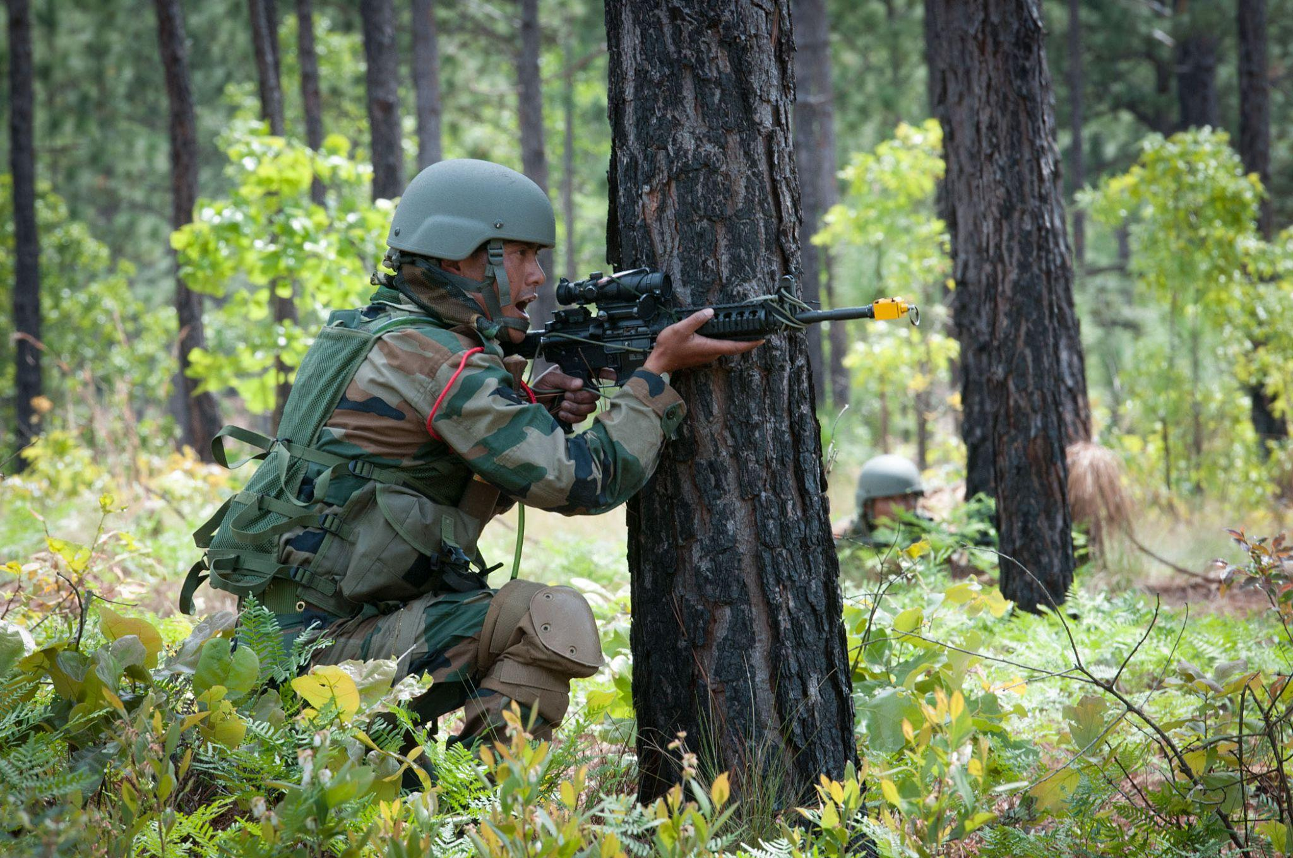
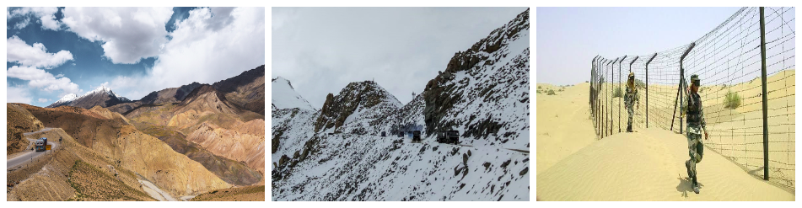
Motivation & Vision
“India has been a victim of terrorism, especially from across the border, over the last several decades” ~ Mr. T. S. Tirumurti
Counter-Terrorist Operations
High degree of situational awareness & effect on targets
Accurate real time inputs are needed and we need to obviate the inherent risks to our OWN soldiers
Surveillance
Manual methods of surveillance and combat are being employed as of now in India
In the past 30 years, 6,500+ soldiers were martyred
Compact Design Solution
Heavy loads reduce mobility, increase fatigue and reduce mission performance
Optimised for the tasks at hand and payload for soldiers
Maneuvering in Difficult Terrains
India-Pakistan border includes desert, marshy-muddy land, valleys, snowy mountains, rocky mountains, glaciers and wild grassfield

Slide 5
Mechatronics
Design of the bot keeping in mind the engineering requirements and usage scenario

Slide 6
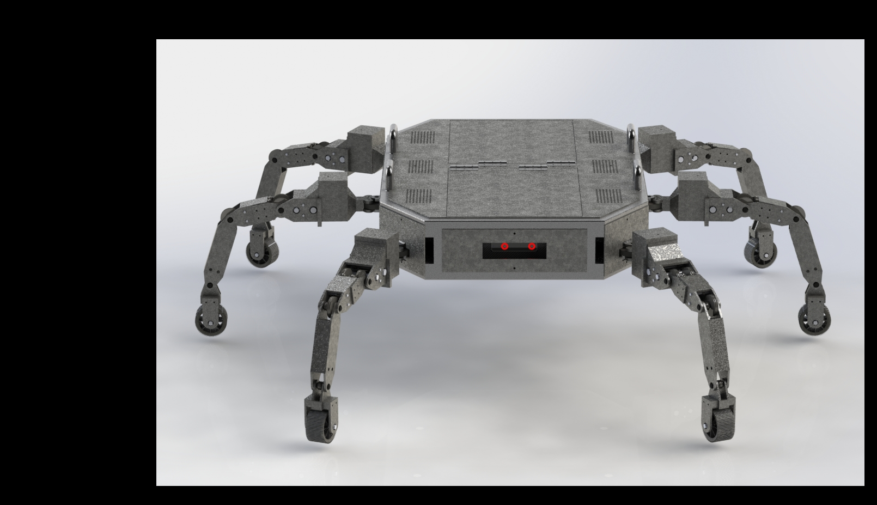
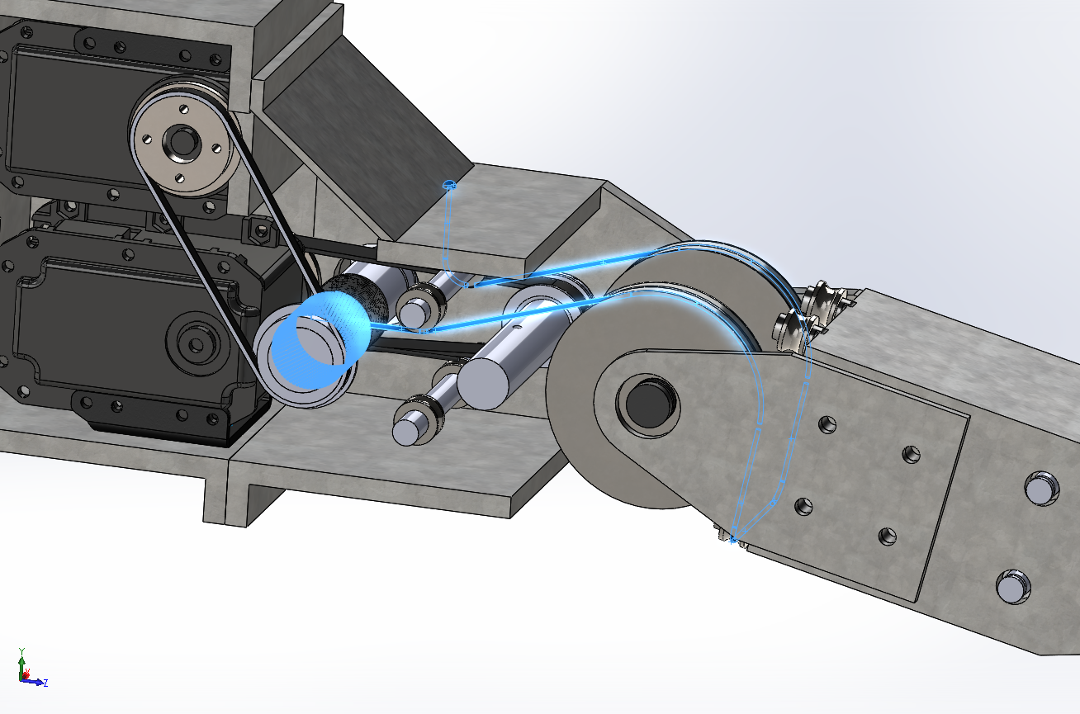
Model

Slide 7
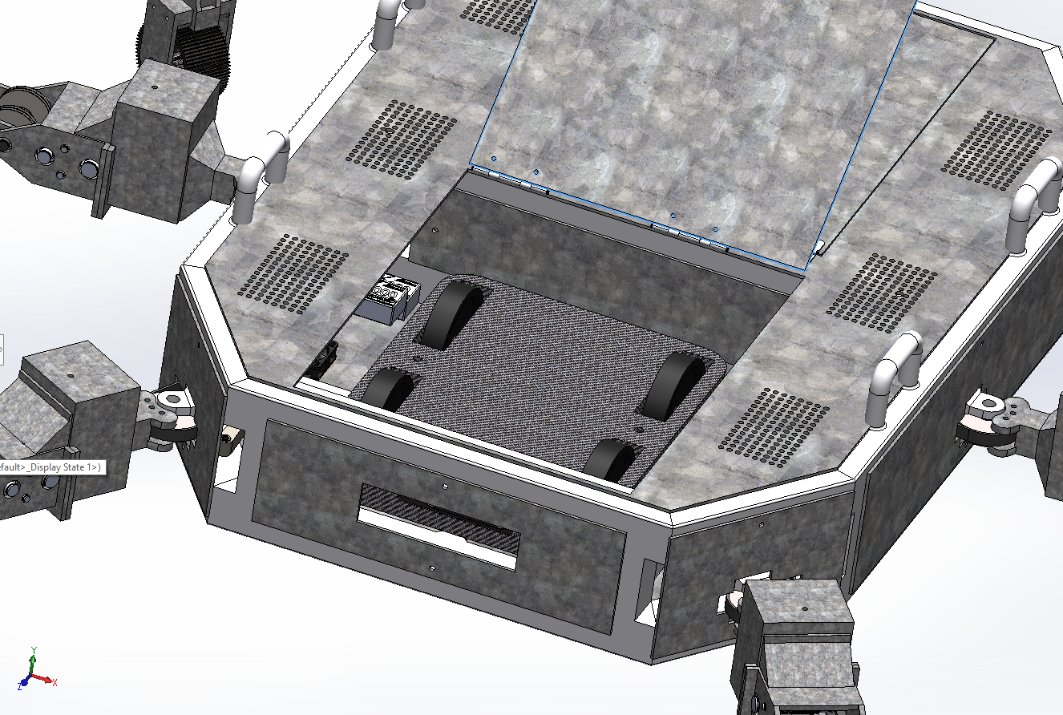
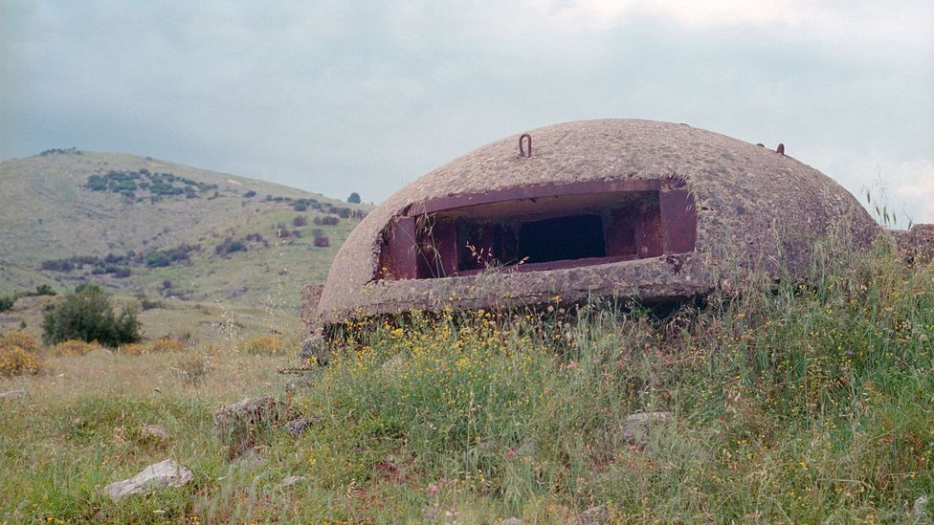
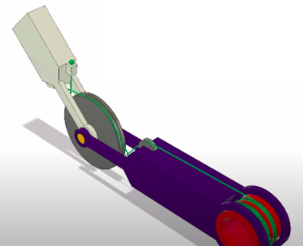
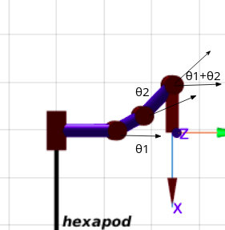
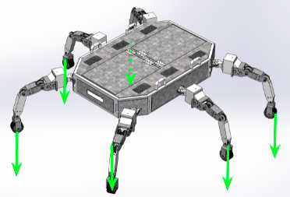
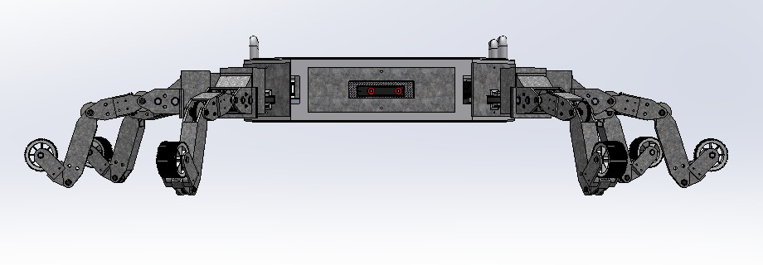
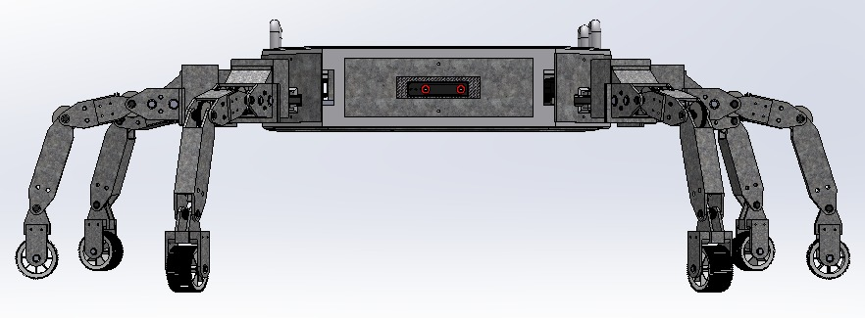
Cable driven reducer for transmission with all the actuator at/near the base
What actuator/transmission to use for leg joints?
(70 kg+25 kg load)
small modular independent bot with all the sensors and computational unit
How do you move in closed space unidentified after reaching near to goal?
Added foldable wheel at the foot, used dynamic decoupling for control
Speed and power requirement in legged motion!!
Legged robot with more legs can walk with payload.
Hence Hexapod
Mobility in rocky and dusty terrain with slopes upto 50°
Why this design?

Slide 8
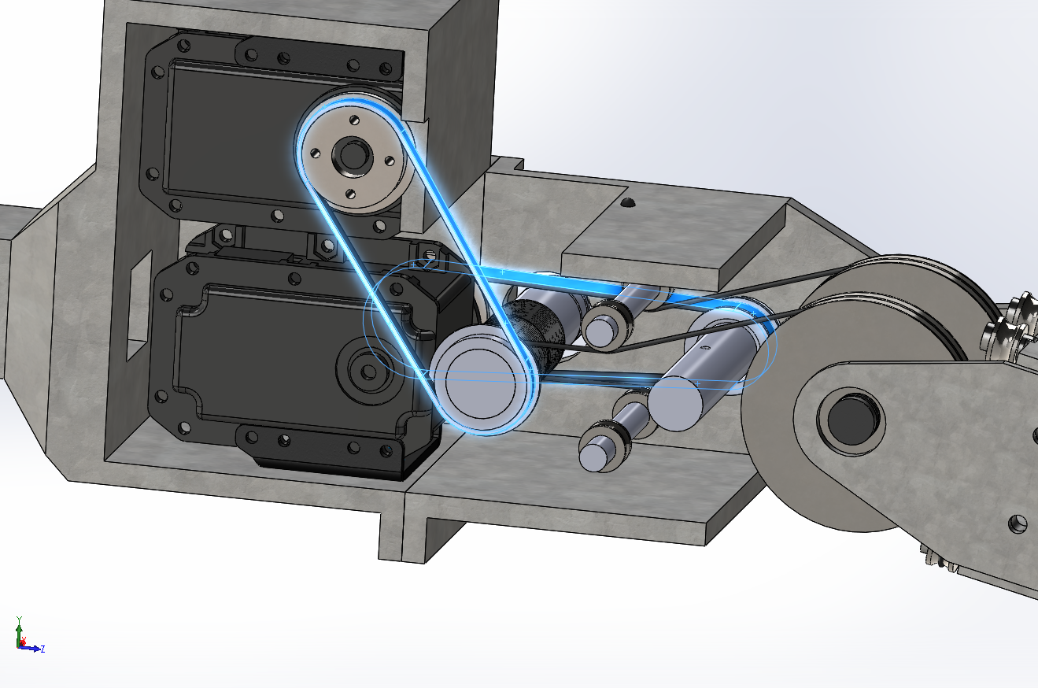
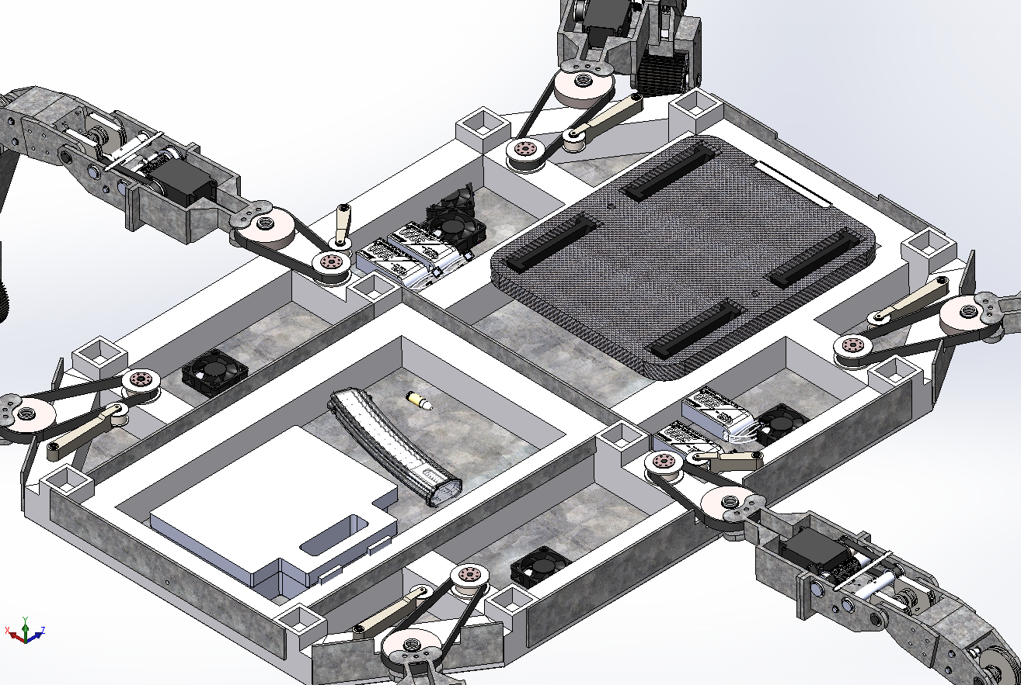
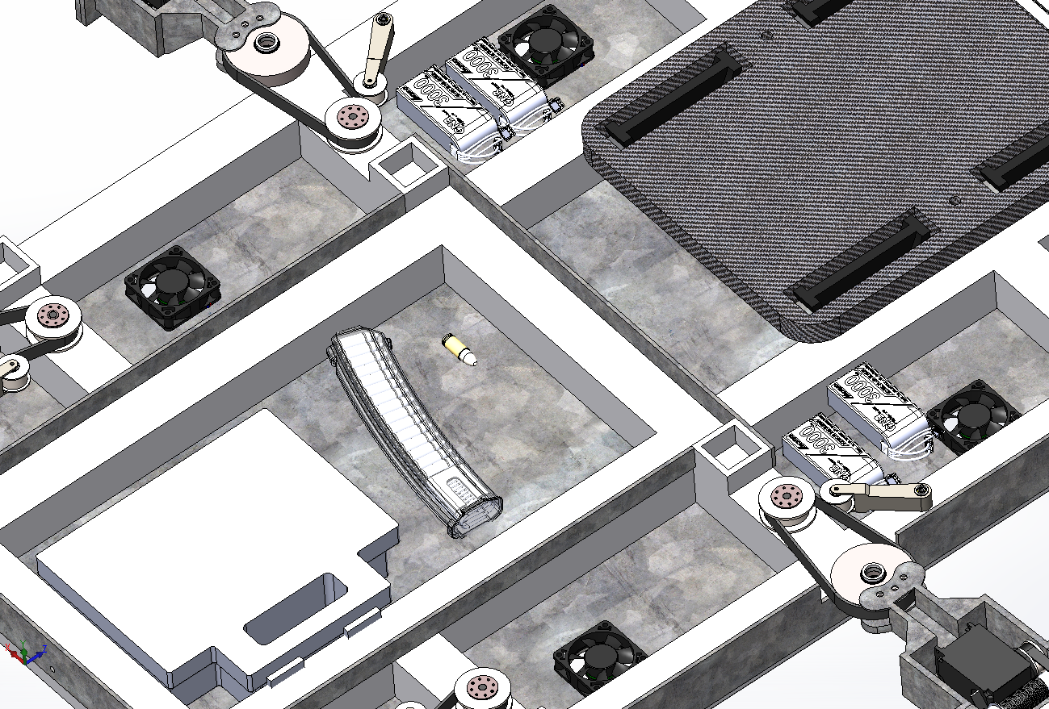



Transmission
Power from motor are transmitted to the links belt drive with a tensioner for avoiding backlash. This is for increased motor life
Used bearing to transfer the bending load on shaft due to belt tension to the chassis
Knuckle joint is used to connect link1 to the chassis.

Slide 9
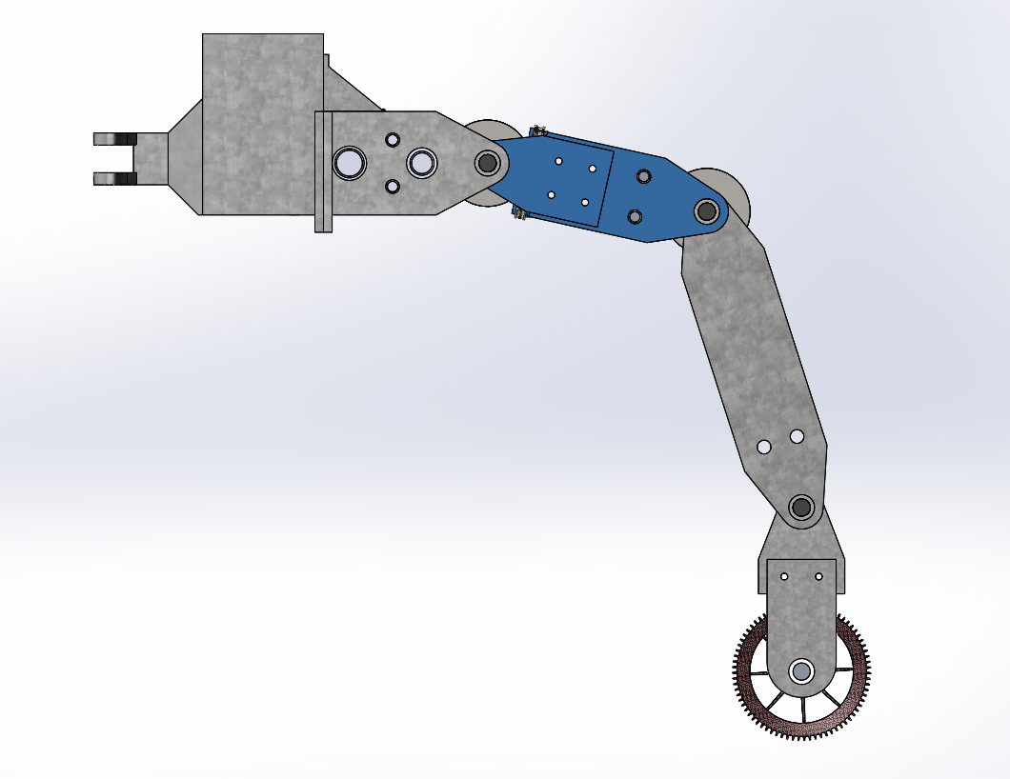
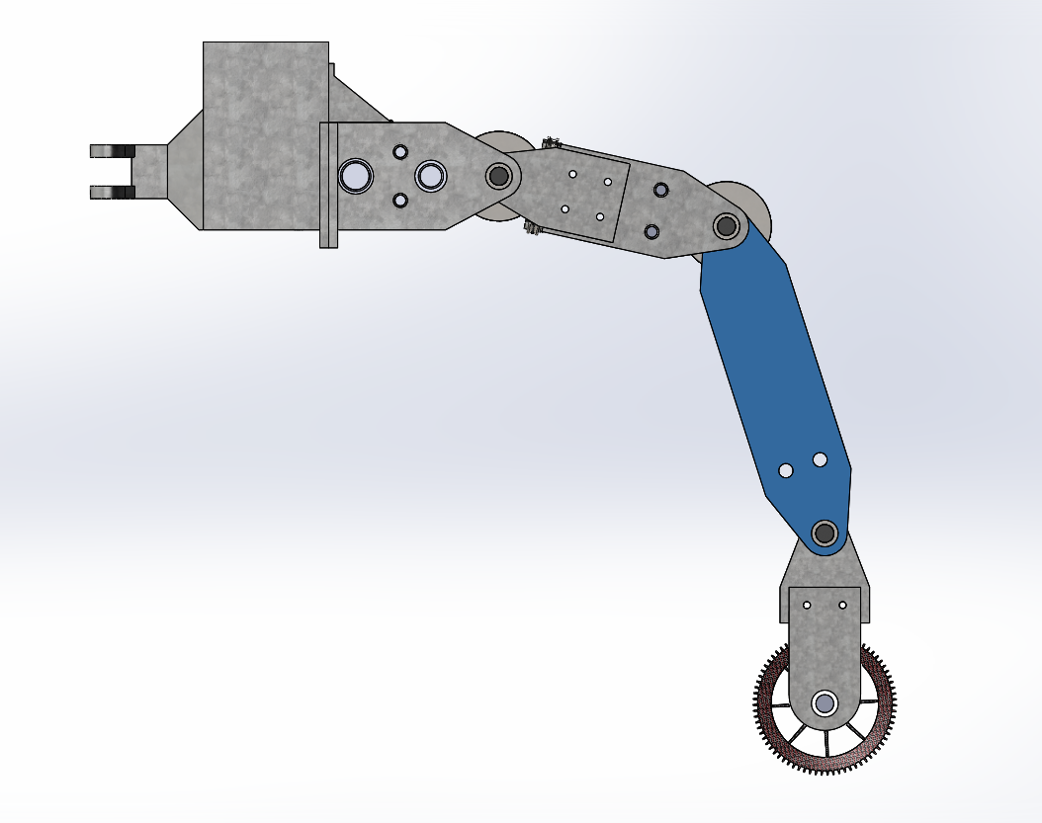
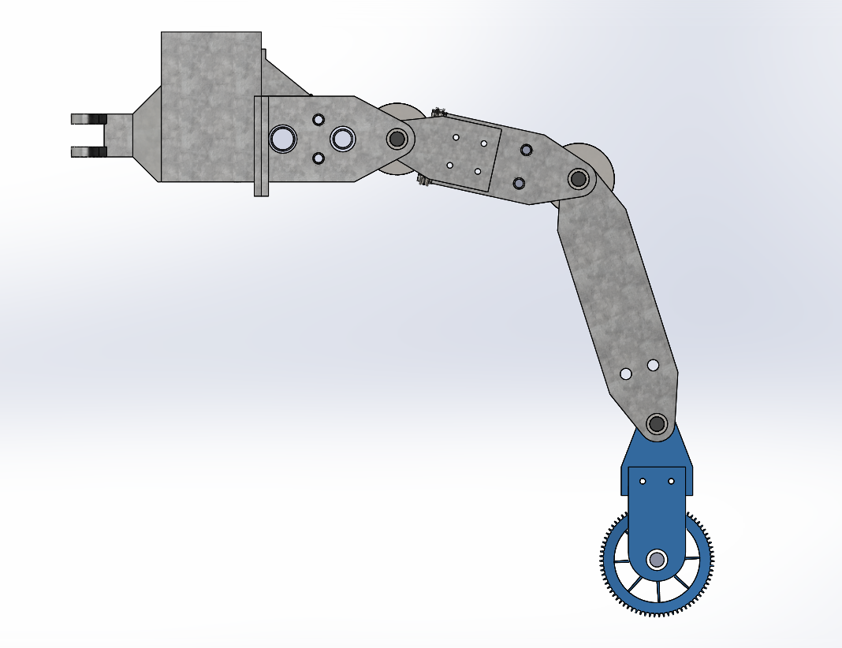
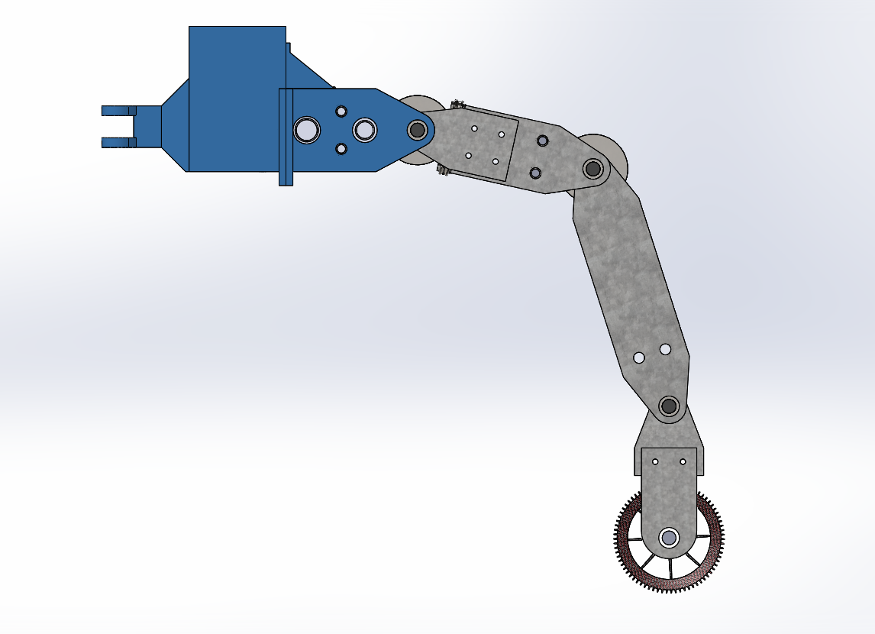
Links
Every leg has 3 degree of freedom, 4 joint with the 4th joint being constrained by the motion of 2nd and 3rd for maintaining desired orientation (dynamic decoupling).

Slide 10
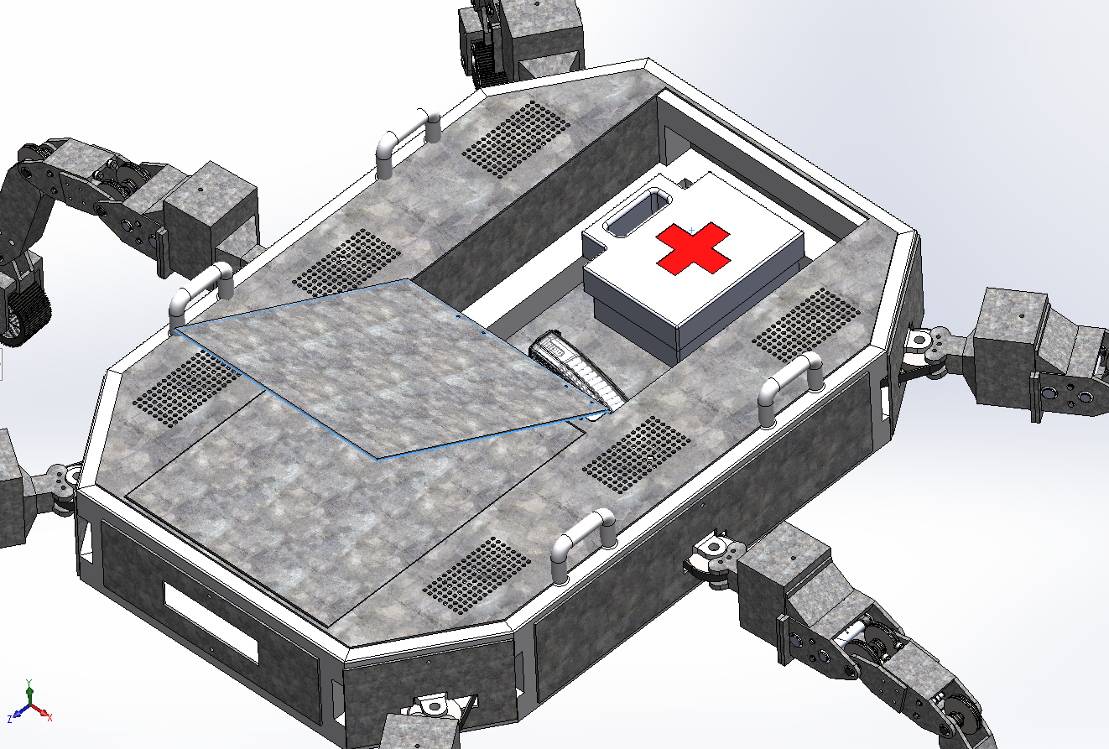
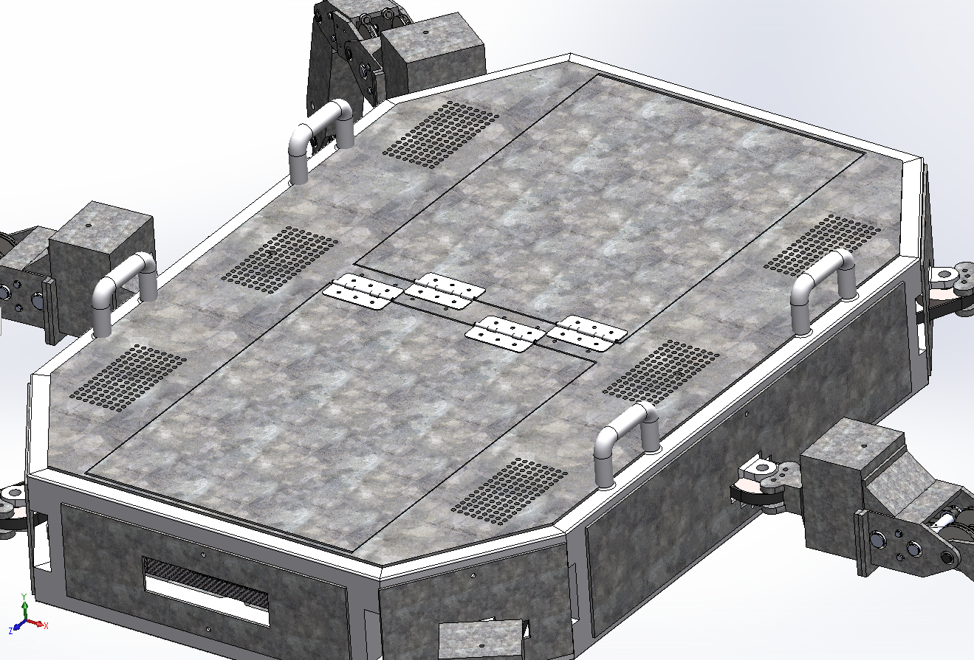
Payload / Storage
A closed storage (400mm*320mm*100mm) has been provided for anuminition and medical kit in addition to the top platform with strap hook for placing weapons or other equipment. The payload capacity is ~70Kg.

Slide 11
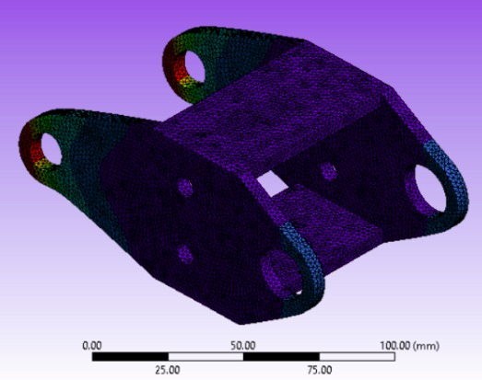
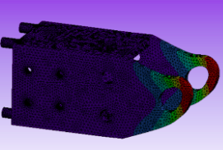
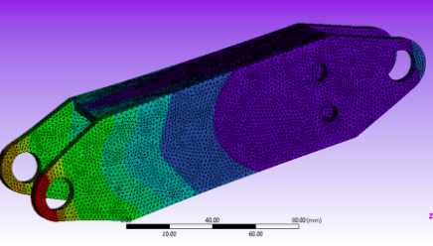
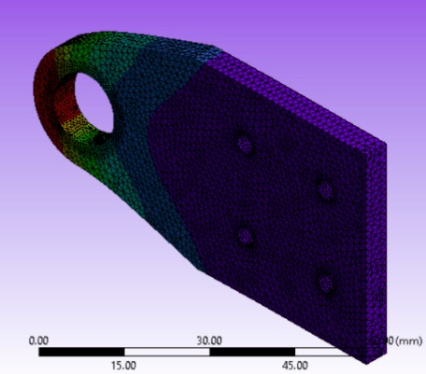
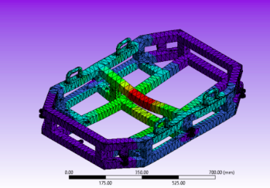
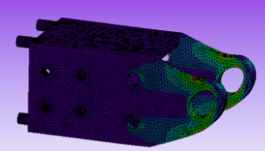
FEM/FMEA Analysis
We Performed FEM and FMEA analysis on the model. FEM analysis suggested that all the parts are subjected to tolerable stress and strain within the safety factor. While FMEA analysis was used for improvising mech design(details in report).

Slide 12
Automation
Artificial Intelligence algorithms to control sensors to perform various tasks autonomously

Slide 13
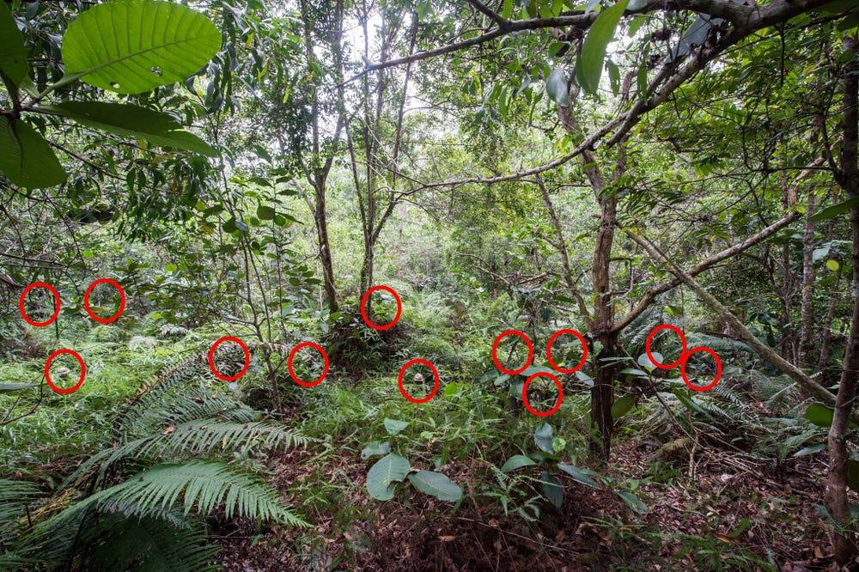


Enemy Detection
The main task that we want our bot to accomplish is the detection of enemies including which are camouflaged in forest trees.
These enemies are very challenging to identify even for humans

Slide 14
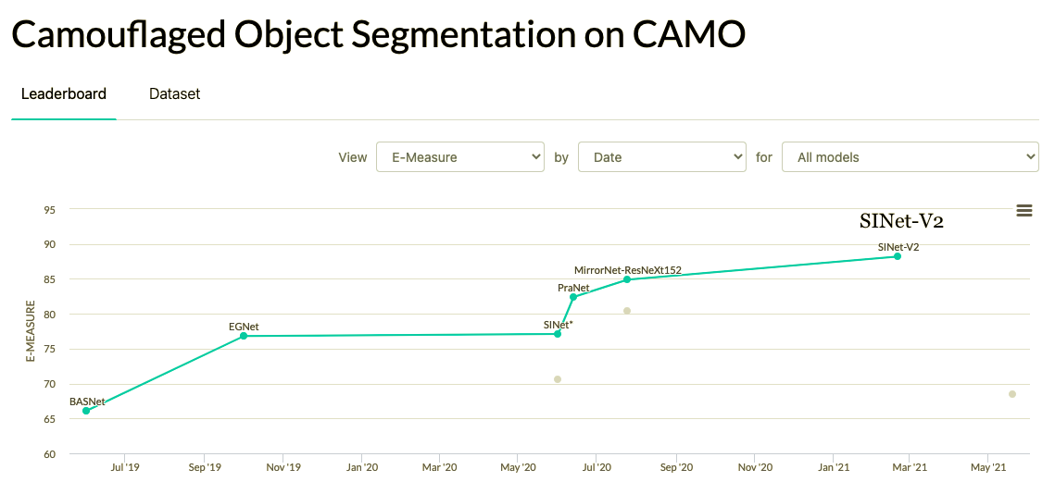
SINet-V2 model
Motivation
SINet-V2 is currently state of the art model for camouflage segmentation with the highest E-measure of 88.2and S-measure of 82.0 on the CAMO dataset
SINet-V2 is currently state of the art model for camouflage segmentation with the highest E-measure of 88.7and S-measure of 81.5 on the COD10k dataset

Slide 15
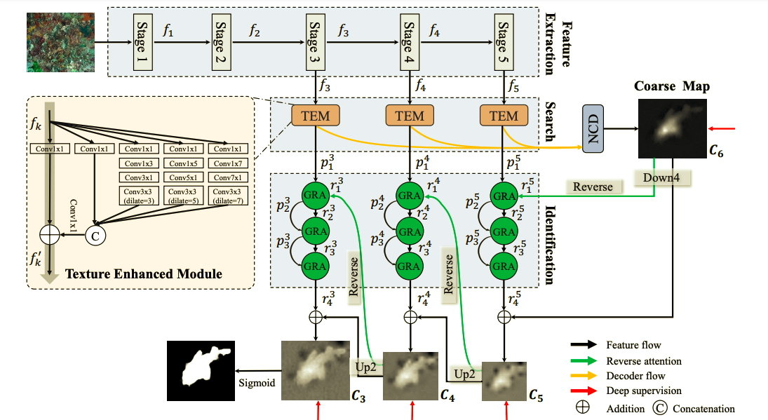
SINet-V2 model
Architecture
Texture enhanced module (TEM) - The TEM is introduced to mimic the textural structure of receptive fields in the human visual system. It is used to capture fine-grained textures with the enlarged context cues.
Neighbor connection decoder(NCD) - The NCD is responsible for locating the candidates with the assistance of the TEM. It is able to provide location information.
Group-reversal attention (GRA) - The GRA blocks reproduce the identification stages of animal predation. These work collaboratively to refine the coarse prediction from the deeper layer.

Slide 16
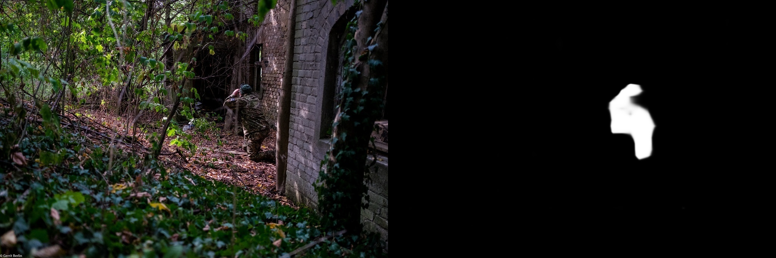
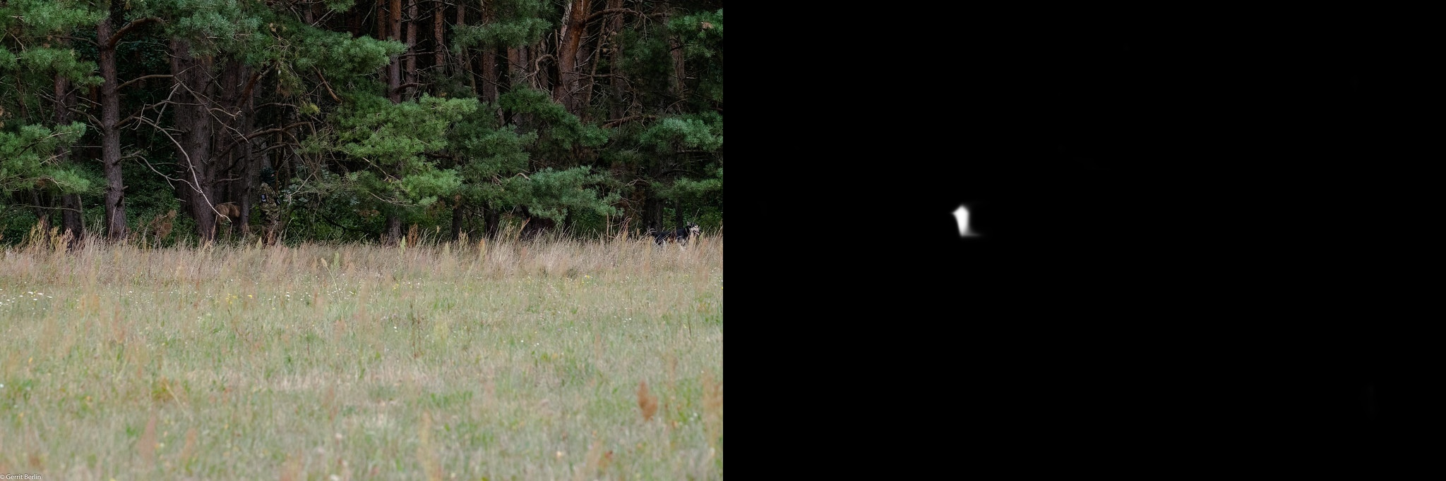
SINet-V2 model
Implementation
Our dataset contains the images of soldiers in forest, among which many are camouflaged. We test our model on these images and our model successfully detects the enemies.
The training and testing experiments are conducted using PyTorch with a single NVIDIA Tesla K80 GPU of 12 GB Memory.
We downloaded the GitHub repository and used a pretrained model.

Slide 17
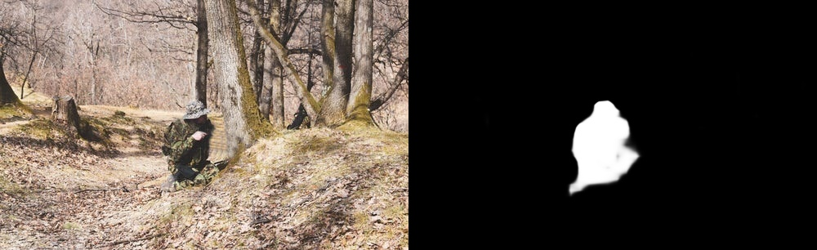
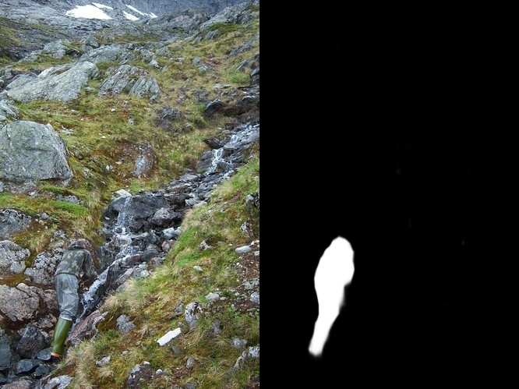
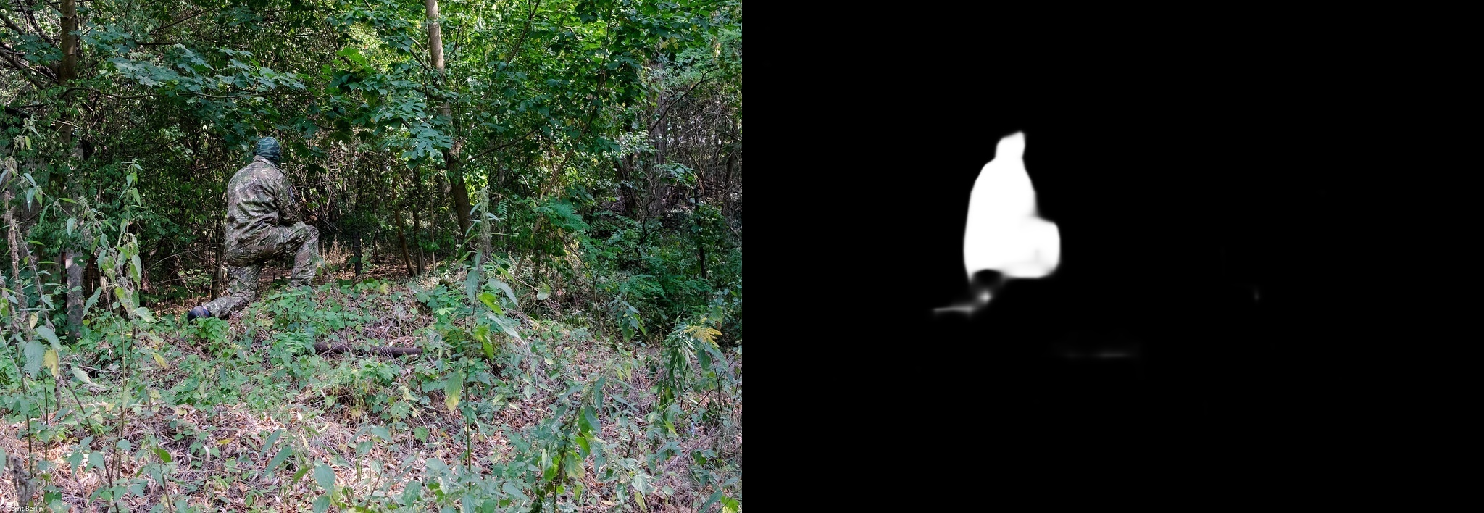
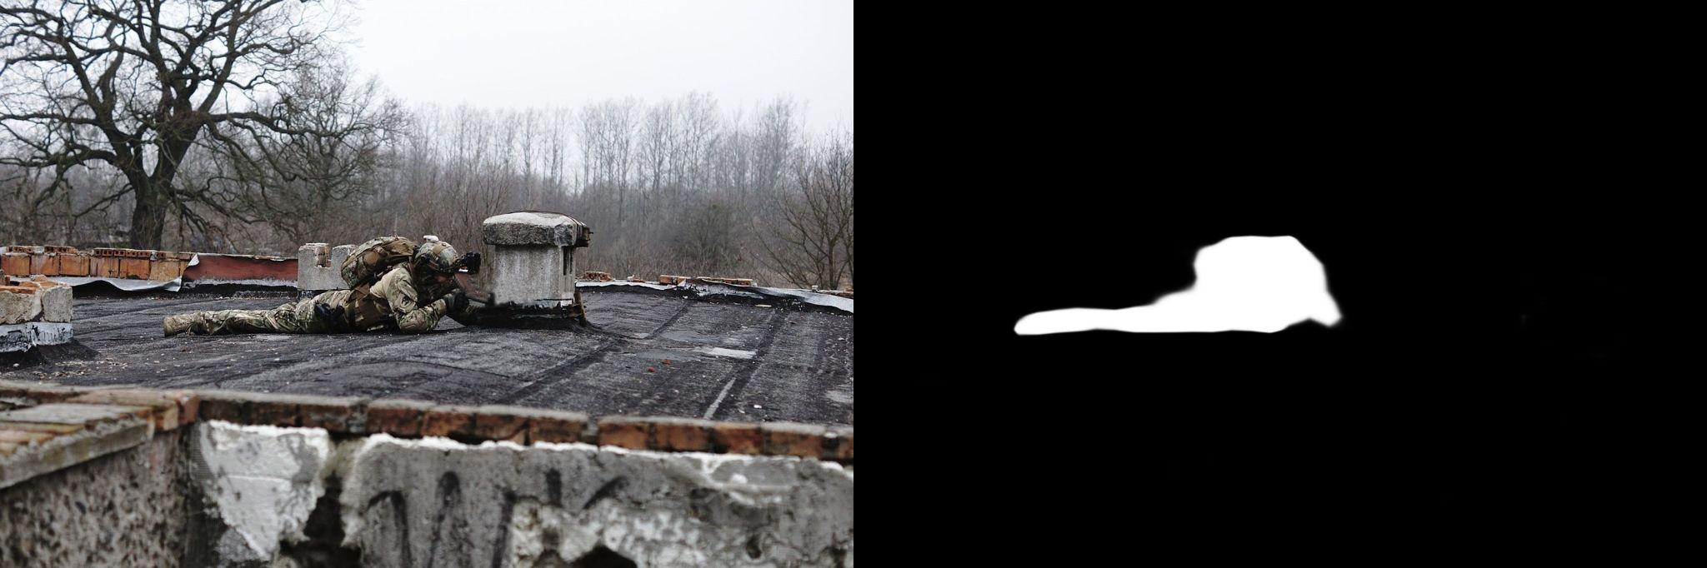
SINet-V2 model
Generalization
It's important that our model is generalizable and able to detect enemies even in different environment than forests

Slide 18
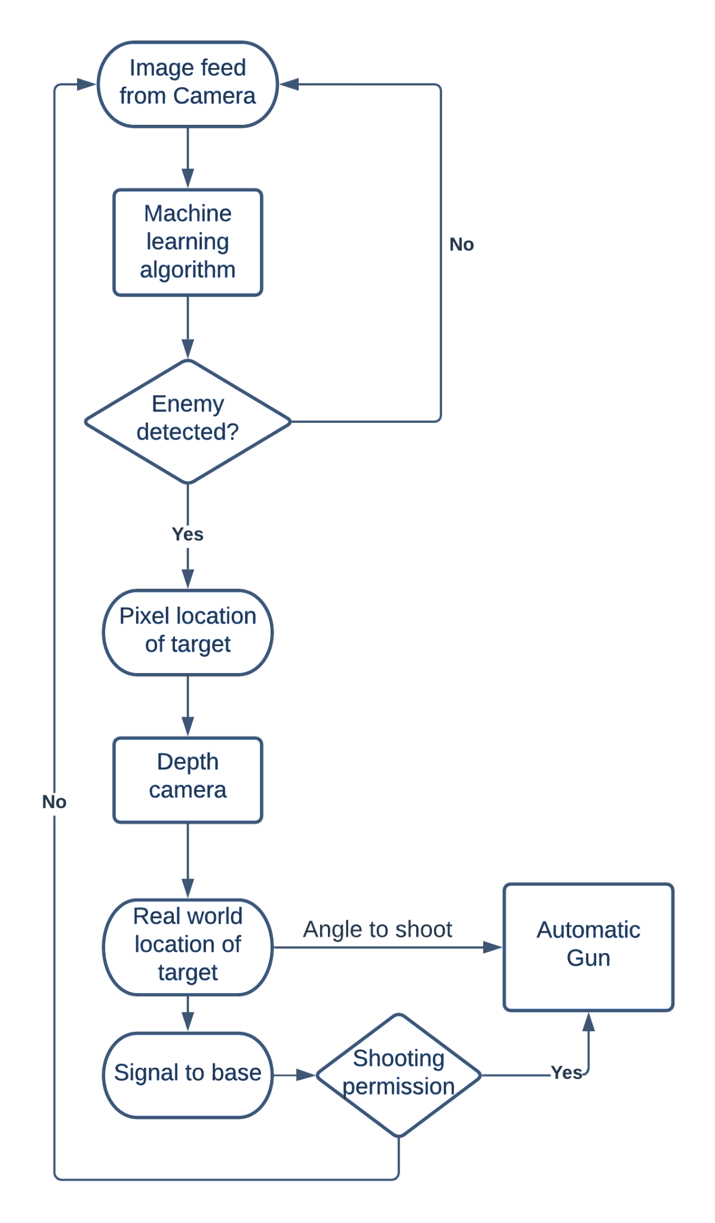
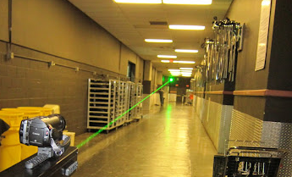
Autonomous shooting
After detecting the enemy using Machine learning, we will find the most appropriate point to shoot.
The pixel location of that point would be passed to the depth camera which would give the global location of that point wrt to our bot.
Using the location, we would calculate the unit vector which is the angle to shoot.
After this our bot would send the signal to base that we are ready to shoot. If the permission is given then the bot would shoot at that angle.

Slide 19
Controls

Slide 20
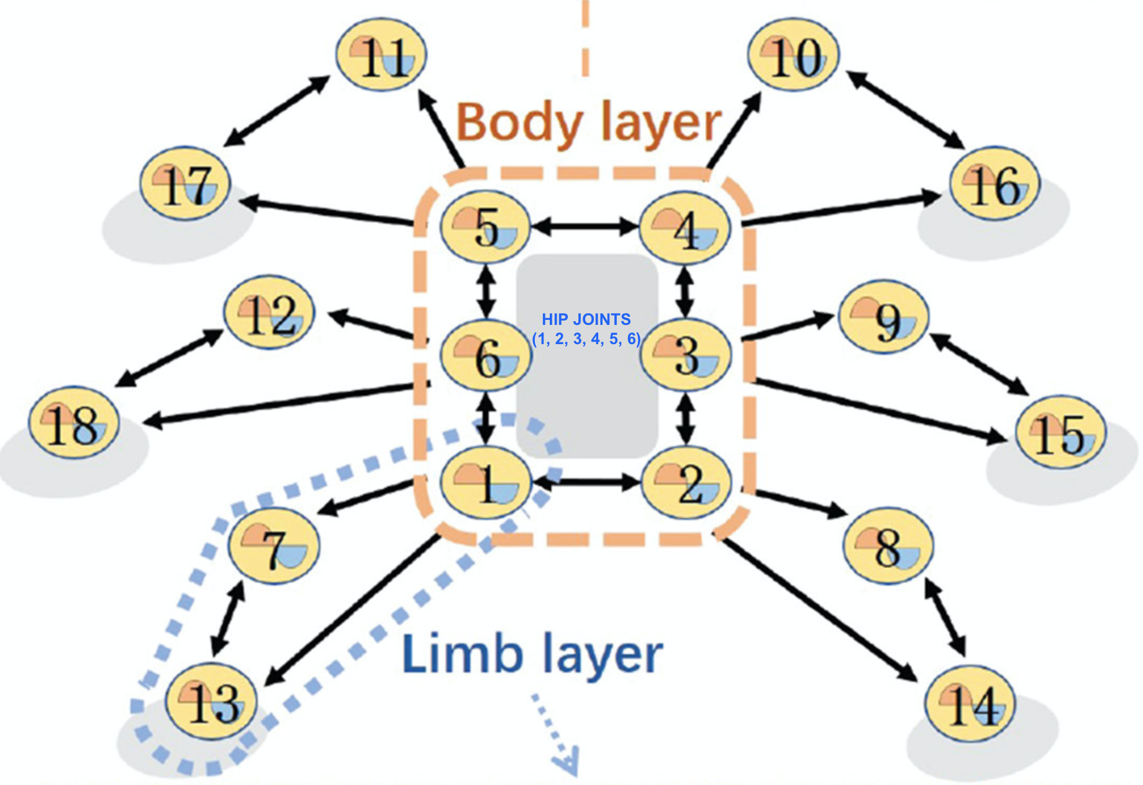

Central Pattern Generator Framework
Requirements:
Generation of stable periodic trajectory for all joint angles
Compatibility of trajectories for stable locomotion of the hexapod
Architecture:
Designing coupled oscillator differential equations for every joint angle
Stable limit cycle periodic solutions for each joint angle
Environment Adaptability:
Varying parameters of the differential equations for change in mode of motion
Bilayer Central Pattern Generator Framework

Slide 21


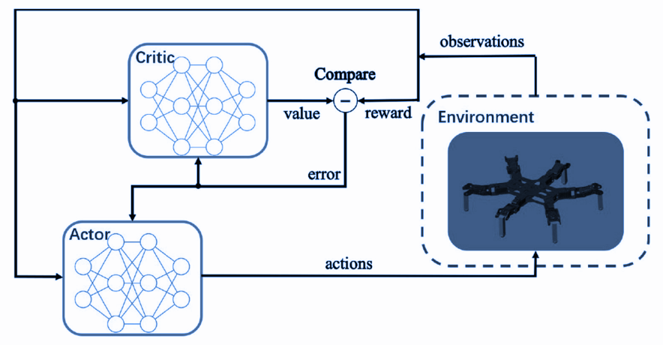

DDPG based RL Motion Controller
Observation Parameters
Deep Deterministic Policy Gradient: Actor-Critic Technique
Actor Network:
policy network
takes the state as input
offers a control policy that outputs the exact action
Critic Network:
Q-value network
takes in state and action as input
outputs the approximate action-value function
Action Space
Reward Function
Operations & Safety Constraints

Slide 22
Cost Analysis

Slide 23
Cost Analysis
Annual cost of a Soldier ~ Rs. 20,80,000
One time cost of UGV ~ Rs. 8,00,000
Domain | Cost
Salary of one soldier | Rs. 15,00,000
Operations & Maintenance | Rs. 2,00,000
Procurement (Arms, Equipments, etc) | Rs. 1,00,000
Research, Development, Test & Evaluation | Rs. 50,000
Revolving & Management Funds | Rs. 50,000
Military Construction | Rs. 1,00,000
Family Housing | Rs. 1,20,000
Base, OCO and Emergency | Rs. 2,00,000
Defense Health and Education Program | Rs. 30,000
Commissary Subsidy | Rs. 30,000
Domain | Cost
Actuator (Servos for Joints) | Rs. 4,50,000
Motors, Wheels, Bearing & Nuts | Rs. 60,000
Materials | Rs. 30,000
Manufacturing | Rs. 1,00,000
Sensors & Computations Units | Rs. 1,00,000
Battery | Rs 30,000
Annual cost of UGV ~ Rs. 14,15,000
Kevlar & Battery coating, bearing wears | Rs. 15,000
Operator Salary & Station Costs | Rs. 14,00,000

Slide 24
Acknowledgment
We would like to take this opportunity to thank Prof. Shantanu Tripathi to provide us the opportunity to work on this project.

Slide 25
Thank You!

